Slide 1
A few questions for you to discuss over lunch
What is grammar and what might it possibly have to do with erotic empowerment?
What is the basic structure of the English sentence?
What is the difference between a cat and a comma?

Slide 2
Exploring erotic empowerment, and grammar in the Australian school curriculum
Garry Collins
retired chalkie & enthusiastic grammar nerd

Slide 3
What might be new grammar terms for you
participants, processes, circumstances
nominalisation
open and closed word classes
grammatical theme

Slide 4
One of those preliminary questions
What is grammar?

Slide 5
Do you understand this?
Grammar: syntax (word order) + morphology (word form)
English the of discussing some be talk of will language the grammar this in I aspects
In this talk I will be discussing some aspects of the grammar of the English language.
In this talk I will be discussing some aspects of the grammar of the English language.
In this talks I was be discussed some aspect of the grammars of the Englishes language.
16 words, but how many “chunks of meaning”?

Slide 6
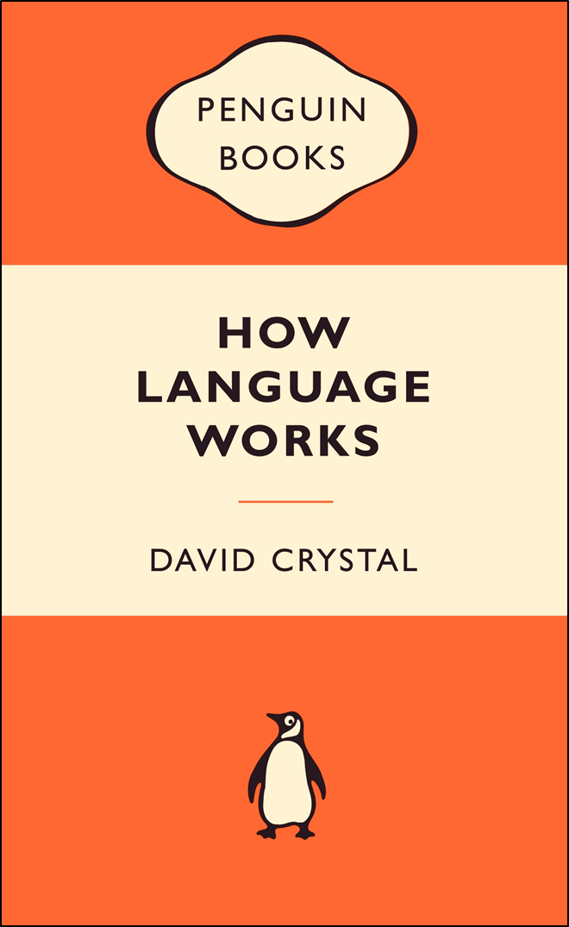
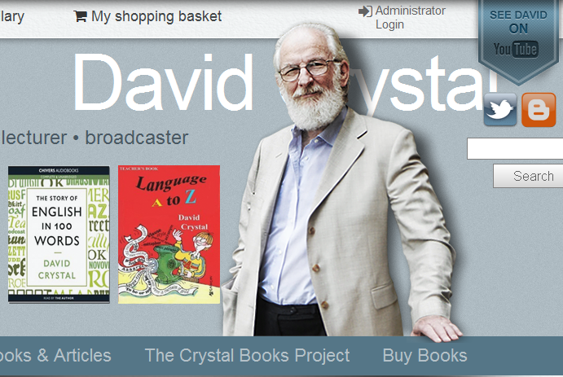
http://www.davidcrystal.com/
In contrast:
“Latin is a highly inflected language”
“English has little inflectional morphology.”
“But what it lacks in morphology, it more than makes up for in syntax.” (Page 239)

Slide 7

Grammar and (?) syntax
From The Australian of 11 August 2006, Page 3
Headline: Students failed by language system
A quote from then Federal Education Minister, Julie Bishop:
“Over recent decades, the teaching of grammar, spelling, syntax and sentence construction has become an optional extra. It should be fundamental. It’s the building blocks for clear and precise communication.”

Slide 8
What the blurb promised
Exploring erotic empowerment

Slide 9
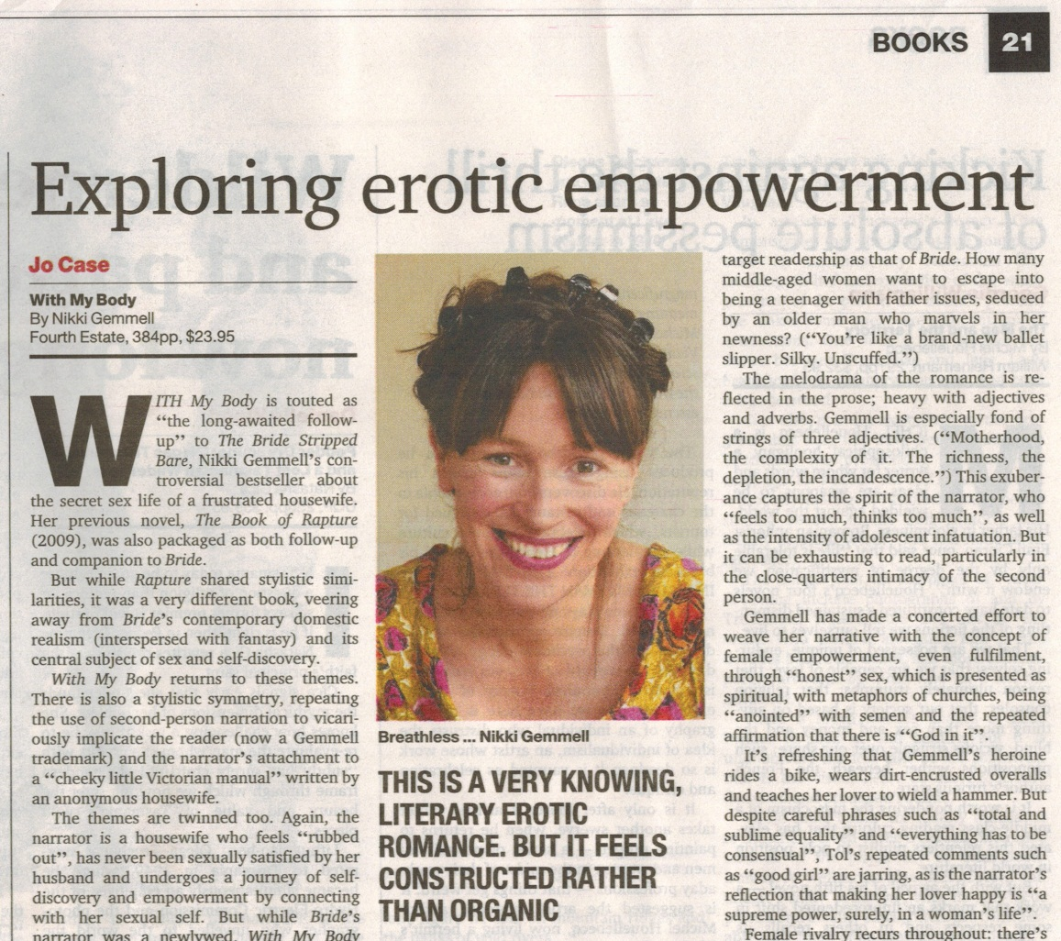
We’ll first consider the title.
A book review in
The Weekend Australian Review
Oct 29-30, 2011

Slide 10
Exploring erotic empowerment
3 words, but how many “chunks of meaning”?
I suggest there are 2 “chunks of meaning”:
Exploring (a process) / erotic empowerment (a thing)
Could it function as a sentence?
The author / is exploring / erotic empowerment.
Grammatical description of the title:
Traditional grammar: a participial phrase
Functional grammar (SFL): a non-finite, (dependent) clause

Slide 11
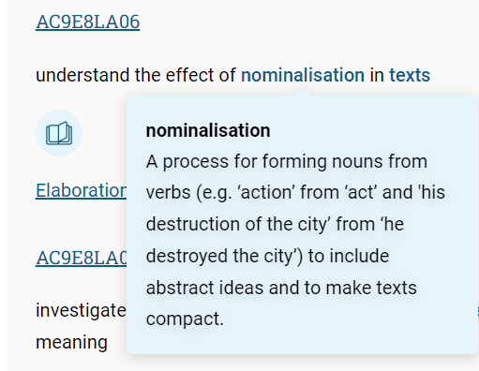
Considering the word empowerment
power
usually a noun
empower
a verb
empowerment
a noun
A Year 8 Content Description
Education empowers people.
Education produces measurable and long-lasting personal empowerment of very real value.

Slide 12
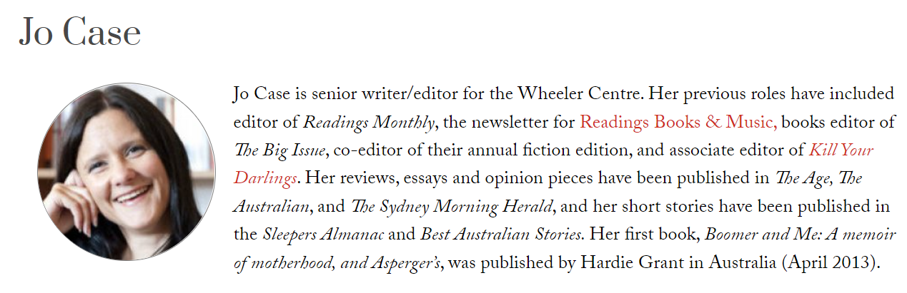
Born 1975
Considering the reviewer
Australian Book Review

Slide 13
The melodrama of the romance is reflected in the prose; heavy with adjectives and adverbs.
Gemmell is especially fond of strings of three adjectives.
(“Motherhood, the complexity of it. The richness, the depletion, the incandescence.”)

Slide 14
Word Classes (parts of speech)
Open Classes | Closed Classes
Nouns | Pronouns (eg. I, me, it, them)
Verbs | Prepositions (eg. in, to, of)
Adjectives | Conjunctions (eg. and, but, if)
Adverbs | Determiners: Articles (a/an, the) + this, those etc
Content words
Grammatical words

Slide 15
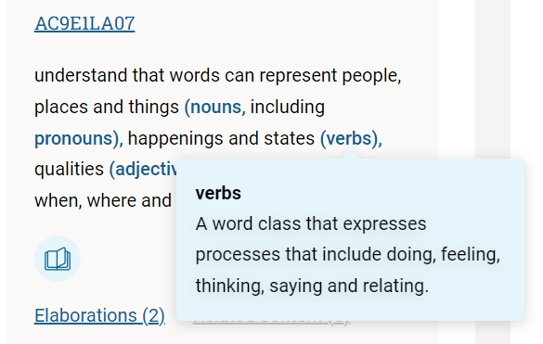
Screenshot from revised Australian Curriculum: English
Year 1
Language Strand
Sub strand:
Language for expressing & developing ideas

Slide 16
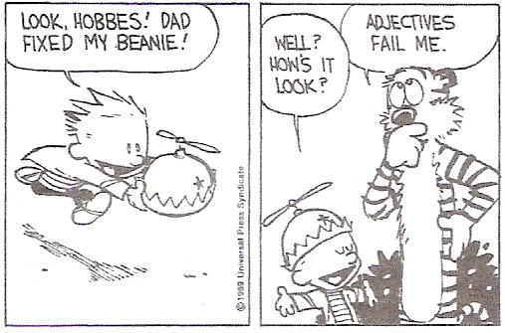
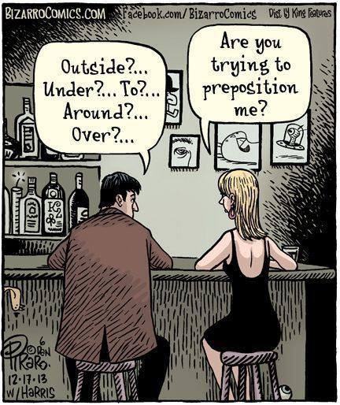
Adjectives: an open class
Prepositions: a closed class

Slide 17
Grammar Rank Scale
Language can be considered at different levels.
Texts
Paragraphs
Sentences
Clauses
Groups & phrases
Words
But language seldom works in just single words.
Word class (part of speech) is just concerned with the word level

Slide 18
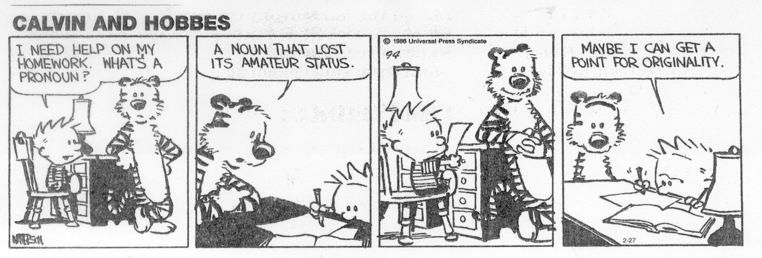
Pronouns & Nouns
Actually, in this instance, the prefix “pro” means “acting as a substitute for” – from Latin, eg Pro Vice Chancellor.

Slide 19
A grammar victim?
an adjective
Gemmell is especially fond of strings of three adjectives. (“Motherhood, the complexity of it. The richness, the depletion, the incandescence.”)
Motherhood | the | complexity | of | it
NOUN | article | NOUN | preposition | pronoun
The | richness | the | depletion | the | incandescence
article | NOUN | article | NOUN | article | NOUN
Related adjectives: motherly, complex, rich, depletive (?), incandescent

Slide 20
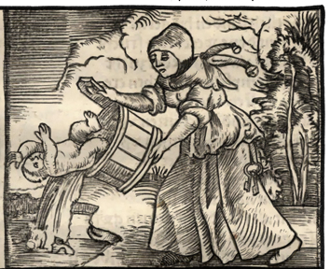
What happened to grammar?
Our reviewer, b 1975, would have gone to school in the 1980s & early 90s.
When I (we?) went to school, grammar consisted of:
  parsing & analysis
  correction of sentences
By the end of the 1960s, research evidence indicated it was not helpful for many kids.
as ends in themselves
out of meaningful context
To some extent, the school system threw out the (grammar) baby with the bathwater in the 1970s.
Grammar based on SFL has featured in QLD syllabuses since 1994

Slide 21
Knowledge of grammar
implicit
explicit
For a good while, there was little explicit knowledge of grammar taught.
But students were always expected to manage grammar, ie apply implicit knowledge.
When we say something is well or poorly written, we’re often largely thinking of the grammatical patterns deployed.

Slide 22
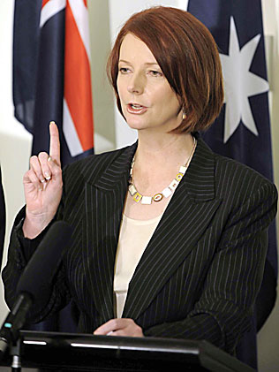
I returned grammar to the Australian school curriculum.
Grammar to make a classroom comeback in national English curriculum
  Justine Ferrari, Education writer, The Australian 17 Oct 2008
GRAMMAR will return to the classroom under the national English curriculum, along with punctuation, spelling, pronunciation and phonics, for all students from the first years of school.
This, of course, implies that they left at some stage.

Slide 23

The former PM’s notion of grammar
“My publicly stated desire was to see a rigorous curriculum and expressly for grammar to be included.
When I was working as a lawyer at Slater & Gordon, I was constantly amazed by the basic errors in the correspondence that was presented for my signature by young solicitors, paralegals and articled clerks. Often I drew a cat with a hat at the bottom of a letter to indicate an apostrophe was in the wrong place;”
Page 248

Slide 24
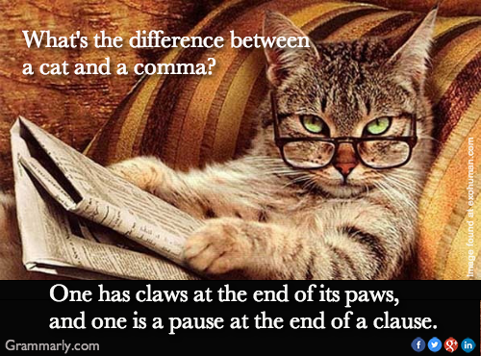
And now this preliminary question

Slide 25
Punctuation and grammar should work in harmony.
But they’re not the same thing.
A neat rhyme but not just at the ends of clauses

Slide 26
We’ll now consider the 1st 2 paragraphs.

Slide 27
The first two paragraphs
With My Body is touted as “the long-awaited follow-up” to The Bride Stripped Bare, Nikki Gemmell’s controversial bestseller about the secret sex life of a frustrated housewife. Her previous novel, The Book of Rapture (2009), was also packaged as both follow-up and companion to Bride.
But while Rapture shared stylistic similarities, it was a very different book, veering away from Bride’s contemporary domestic realism (interspersed with fantasy) and its central subject of sex and self-discovery.
Is this allowed? – beginning a sentence with a conjunction

Slide 28
Grammar
description
prescription
So-called “rules” are really generalisations
How the language does work
How the language should be used

Slide 29
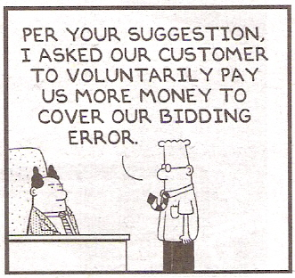
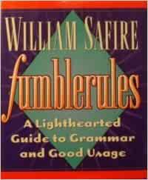
Some grammar rules (?) for writers
Verbs has to agree with their subjects ✓
A preposition is not a word to end a sentence with. ✗
Try to never split infinitives. ✗

Slide 30
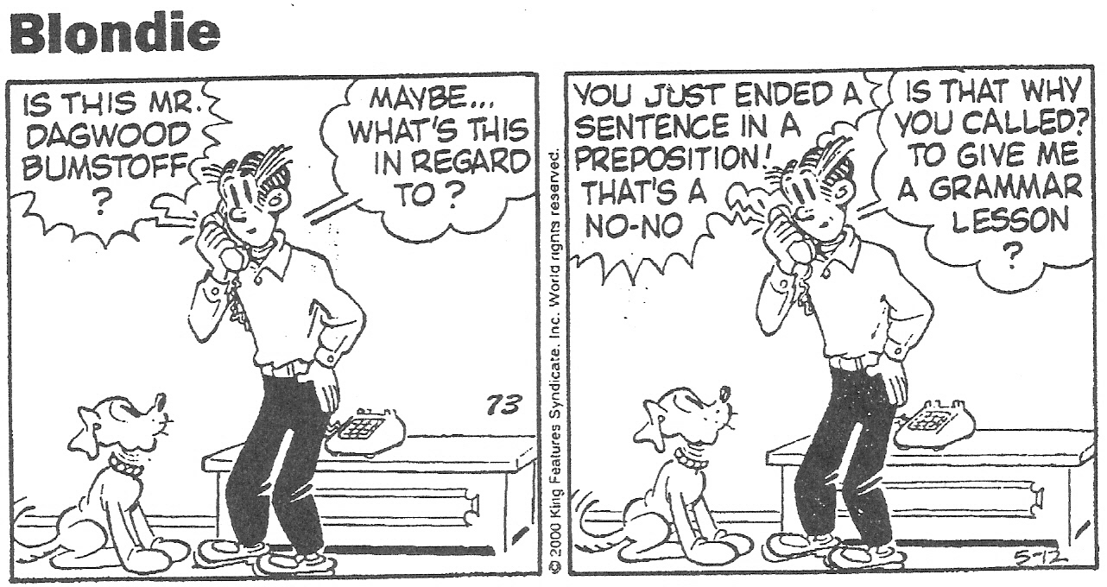
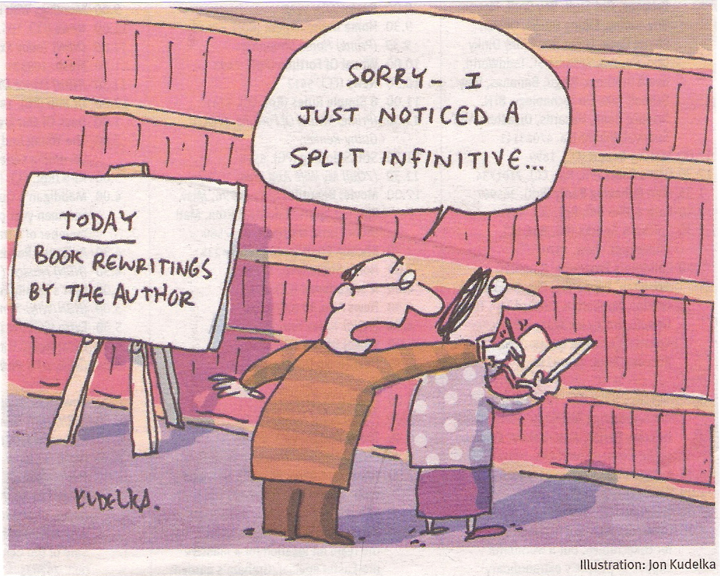
It is important to never split infinitives!
‘The insistence on never ending a sentence with a preposition is the kind of arrant pedantry up with which I will not put.’
Attributed to Winston Churchill

Slide 31
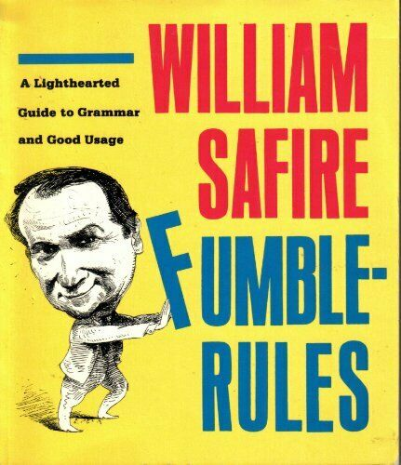
Some grammar rules (?) for writers
Verbs has to agree with their subjects ✓
A preposition is not a word to end a sentence with. ✗
Try to never split infinitives. ✗
And you should not begin a sentence with a conjunction.

Slide 32
Is it OK to begin sentences with conjunctions?
And the earth was without form, and void; and darkness was upon the face of the deep.
King James version of The Bible, Genesis, Chapter 1, Verse 2
Thus Mr Casaubon remained proudly, bitterly silent. But he had forbidden Will to come to Lowick Manor, and he was mentally preparing other measures of frustration.
Middlemarch, George Eliot, Chapter XXXVII
And with these words he hastily left the room, and Elizabeth heard him the next moment open the front door and quit the house.
Pride and Prejudice, Jane Austen, Chapter XXXIV

Slide 33
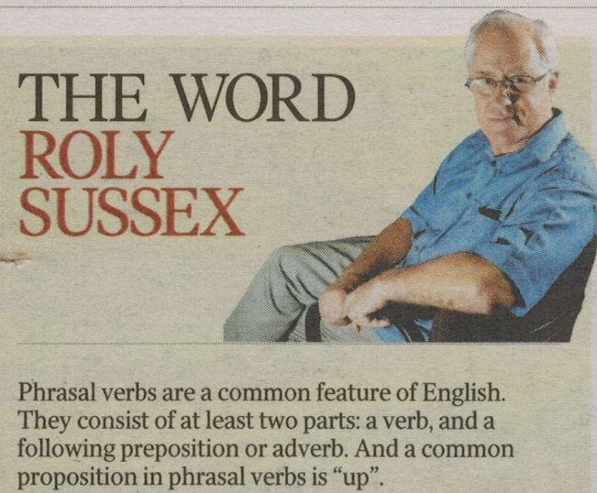
Phrasal verbs
And here’s Roly Sussex,
Emeritus Professor of Applied Language Studies at the School of Languages and Comparative Cultural Studies of the University of Queensland,
beginning a sentence with the conjunction “and”.

Slide 34
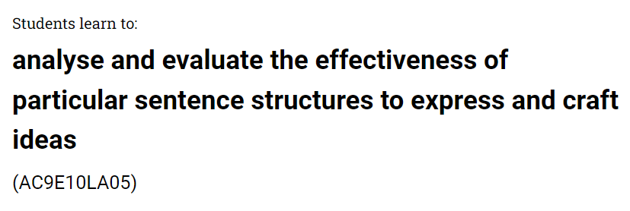
A year 10 Content Description
An elaboration
recognising that a sentence can begin with a coordinating conjunction for stylistic effect; for example,
“And she went on planning how she would manage it.”

Slide 35
Things that should be resisted
Some genuine grammar errors

Slide 36

your shit
(a noun group)
you’re shit
= you are shit
(a clause)
This slide has been censored.
your & you’re (+ yore & yaw) are homophones

Slide 37
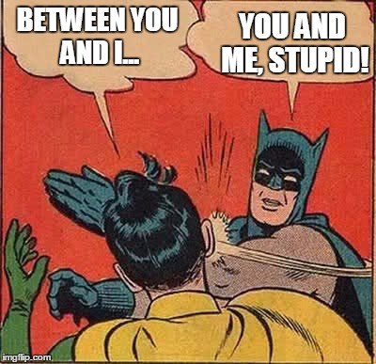
Don’t cross Batman on this one.
Grammatical case
I / me washed the car.
The dog bit I / me.
Give it to I / me.

Slide 38
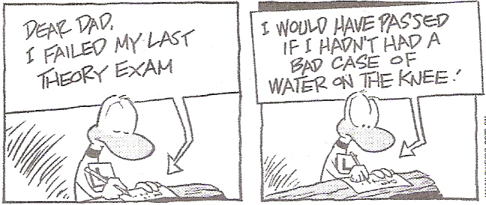
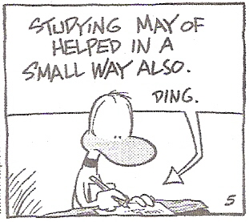
This is correct
Is there a grammar problem here?
I failed my last theory exam.
I would have passed if I hadn’t had a bad case of water on the knee.
Studying may of helped in a small way also.
a common misunderstanding NOT an accepted standard pattern in English grammar.

Slide 39
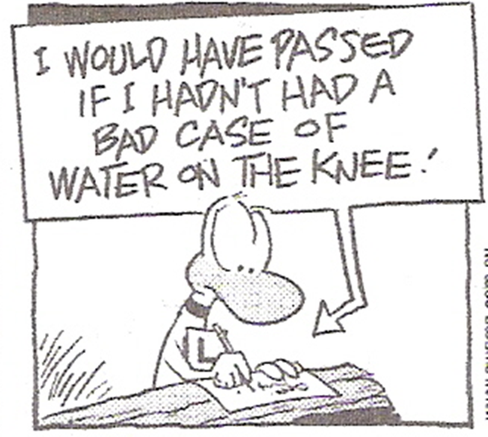
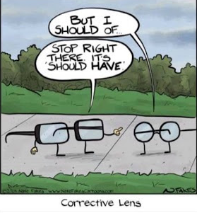
A prevalent misunderstanding
I would have passed the exam. ✓
I would’ve passed the exam. ✓
I would of passed the exam. ×

Slide 40
Another of those preliminary questions
What is the basic structure of the English sentence?

Slide 41
Basic structure of the English sentence?
subject - verb - object
The Club | serves | excellent meals
subject | verb | object
What about this bit?
The Club | was formed | in 1892
subject | verb | ?
Notes:
The slide heading says “clause / sentence”. That’s because what we have here is a simple sentence comprising just a single clause. But what’s a clause? I suggest that it is best thought of as a message built around a verb group. The verb group here – and there’s only one – is “wrote”. Yes, it’s a 1-word group.
People of my vintage who were taught traditional grammar at school will often say that the basic structure of the English sentence is Subject – Verb – Object. And that pattern certainly accommodates this particular sentence. Samuel Taylor is the subject, what this message is about, and is also the entity doing the writing. The other entity here, “a famous poem”, represents what he wrote.

Slide 42
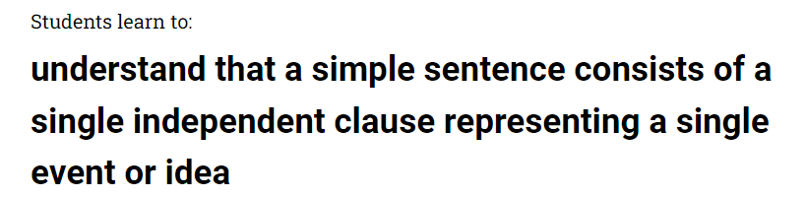
AC:E v9 Year 1 Language Strand content description
Elaboration: knowing that a single event or idea can include
a process, a happening or a state (verb),
the participant or who or what is involved (noun group/phrase), and
the surrounding circumstances (adverb group/phrase)
Elaboration: understanding that simple sentences answer questions such as,
“what is happening?” and
“who or what is involved?” along with
details such as “where?”, “when?”, “how?”

Slide 43
Elements in clauses (‘chunks of meaning’)
The Club | serves | excellent meals
Participant | Process | Participant
noun group | verb group | noun group
active voice
The Club | was formed | in 1892
Participant | Process | Circumstance: Time
noun group | verb group | prepositional phrase
passive voice

Slide 44
Thinking about order
passive voice
The Club was formed in 1892.
The military commandant of the time formed the Club in 1892.
In 1892, the Club was formed.
In 1893, Brisbane suffered a major flood.
active voice
The mechanism at play here is called grammatical theme
Clause elements: Participants Process Circumstances

Slide 45
A (version 8) AC:E Content Description re grammatical Theme
Year | Strand | Sub strand | Content Description
8 | Language | Text structure & organization | Understand how coherence is created in complex texts through devices like lexical cohesion, ellipsis, grammatical theme and text connectives (ACELA1809)
And in simple ones too
The element of a message deployed first.
Notes:
It gets a mention in this Year 8 Content Description. The wording cites “complex texts” but the mechanism also applies to simple ones. Grammatical theme is the element of a message which is placed first. In multi-clause sentences there is a choice about which clause to begin with. And at the level of a single clause, the grammatical theme could be a Participant, a Circumstances, or the Process.

Slide 46
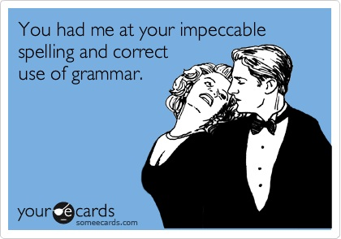
The AC:E & sensible English teaching are not just about correct vs incorrect notions of grammar.

Slide 47
Grammar
a set of rules
a box of tools

Slide 48
That’s it.
Questions or comments?

